Slide 1
Improved SOURCE OF DRINKING WATER
CAPSTONE PROJECT
Presented By:
Student Name-Harsh Kunal
College Name-Haridwar University
Department-Cse-Ai-Ml

Slide 2
OUTLINE
Problem Statement
Proposed System/Solution
System Development Approach (Technology Used)
Algorithm & Deployment
Result (Output Image)
Conclusion
Future Scope
References

Slide 3
Problem Statement
Maternal health remains a critical public health challenge in India, particularly in rural and underserved regions. Despite national programs and Sustainable Development Goals (SDGs), disparities persist in maternal mortality rates, antenatal care coverage, and institutional deliveries. This project aims to analyze data from the National Family Health Survey (NFHS-5) and related sources to assess maternal health indicators such as antenatal care visits, skilled birth attendance, and postnatal care. By identifying regional and socio-economic disparities, the study will generate actionable insights to support evidence-based policymaking. The ultimate goal is to ensure equitable maternal health services and contribute to India’s progress on SDG 3 (Good Health and Well-being).

Slide 4
Proposed Solution
Proposed Solution: Tracking Maternal Health Progress in India
Strengthen Healthcare Infrastructure
  Build and maintain maternal health centers in rural and underdeveloped areas.
  Upgrade existing hospitals, delivery wards, and emergency obstetric care facilities.
Promote Preventive & Holistic Care
  Encourage regular antenatal check-ups, nutritional support, and vaccination programs.
  Ensure continuous monitoring of maternal health indicators to prevent complications.
Community Engagement & Awareness
  Conduct awareness campaigns about safe pregnancy practices and institutional deliveries.
  Train local health workers (ASHA, ANMs) to monitor and support maternal health.

Slide 5
System Approach
System Requirements
IBM Watson Studio Lite (cloud platform)
Laptop/Desktop with internet access
NFHS-5 dataset (CSV)
Libraries Required
pandas – data manipulation
numpy – numerical computations
matplotlib & seaborn – data visualization
Optional: plotly, folium – interactive maps and plots
Methodology
Upload and clean maternal health data using Data Refinery.
Analyze key indicators: antenatal care coverage, institutional deliveries, maternal mortality.
Visualize trends and correlations (education, socio-economic status, rural vs urban).
Generate insights to guide policy and improve maternal health outcomes.

Slide 6
Algorithm & Deployment
Algorithm Selection
Use supervised machine learning algorithms such as Random Forest Classifier or Gradient Boosting to predict maternal health outcomes (e.g., likelihood of institutional delivery).
These algorithms handle structured survey data well, capture complex relationships, and provide interpretable results for policy decisions.
Data Input
Input features include state/region identifiers, rural/urban classification, socio-economic indicators, education level, antenatal visits, and healthcare access.
Training Process
Split dataset into training and validation sets.
Preprocess data: handle missing values, encode categorical variables, and scale features.
Train model using cross-validation and hyperparameter tuning.
Prediction Process

Slide 7
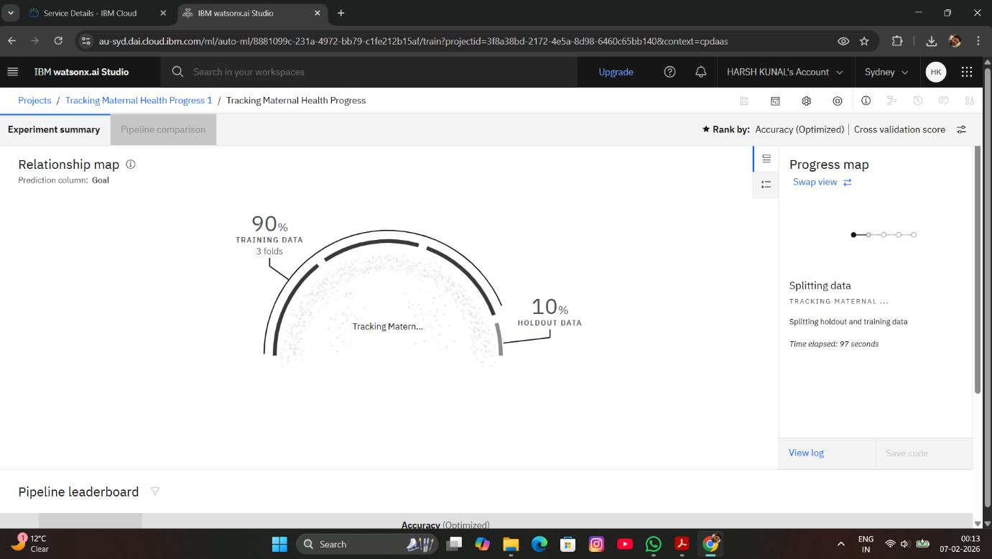
Result
.

Slide 8
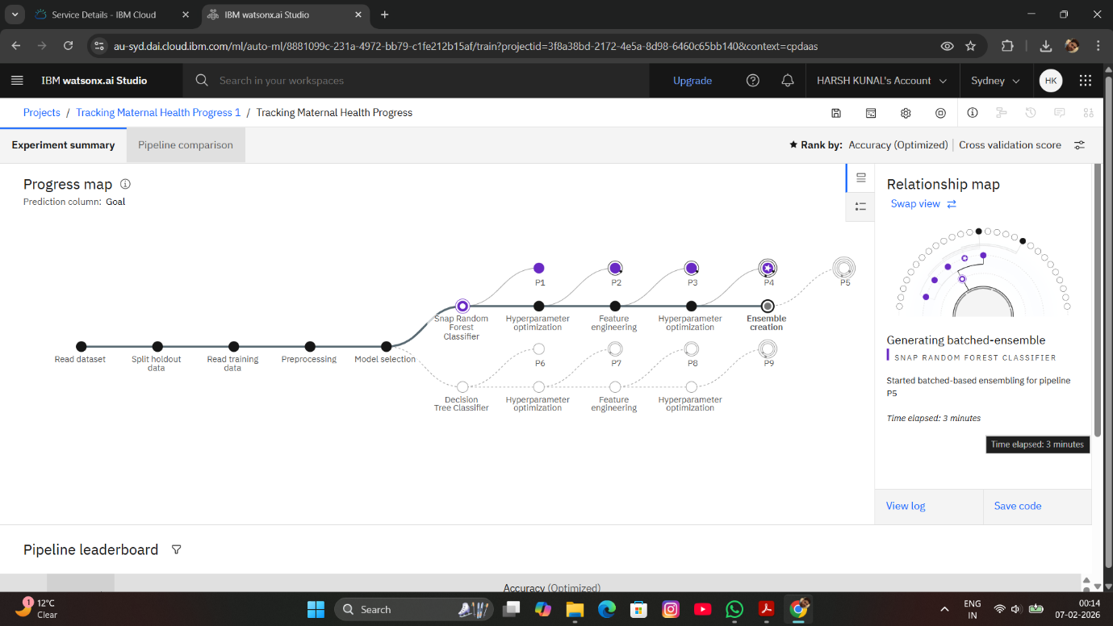
RESULT

Slide 9
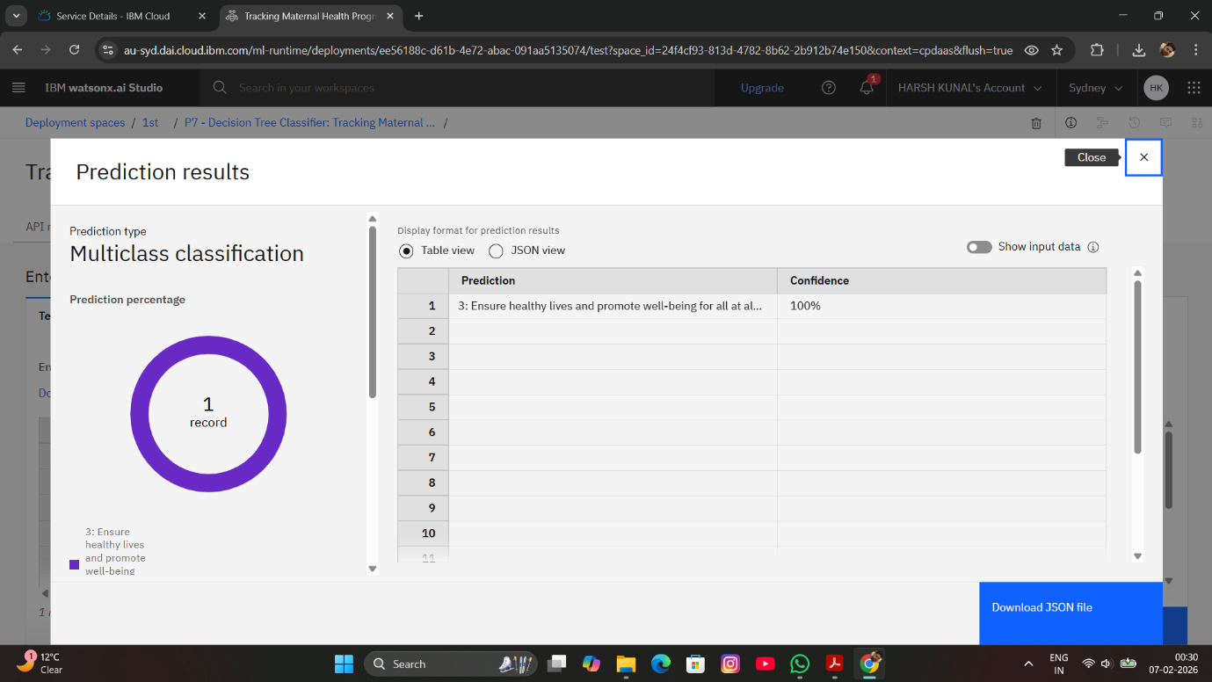
RESULT

Slide 10
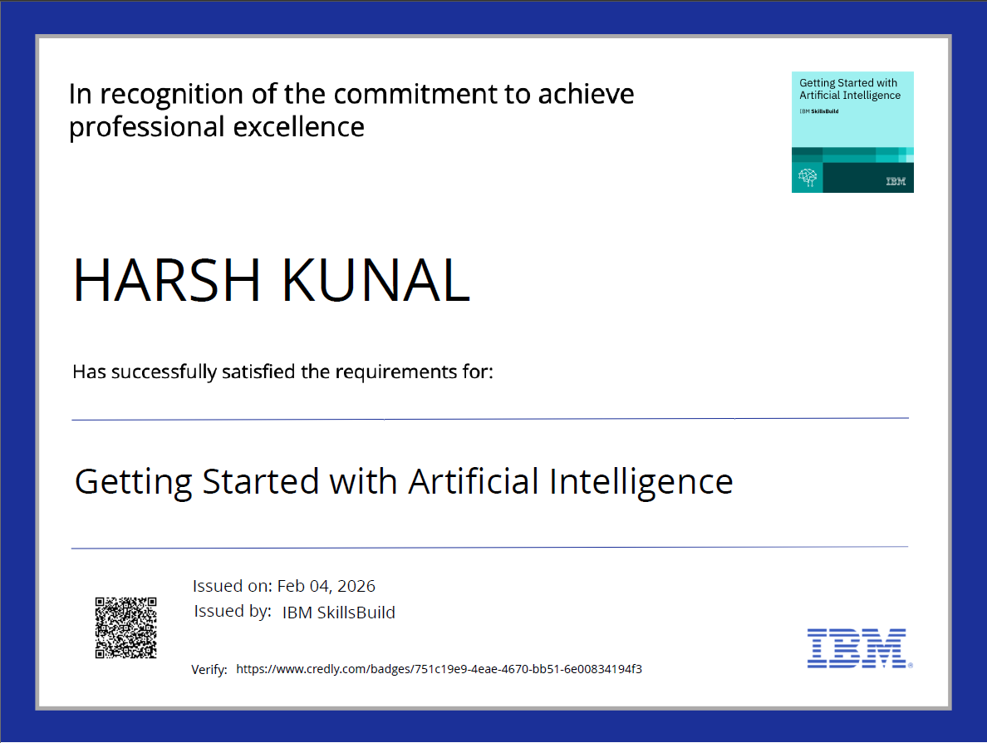
CERTIFICATES

Slide 11
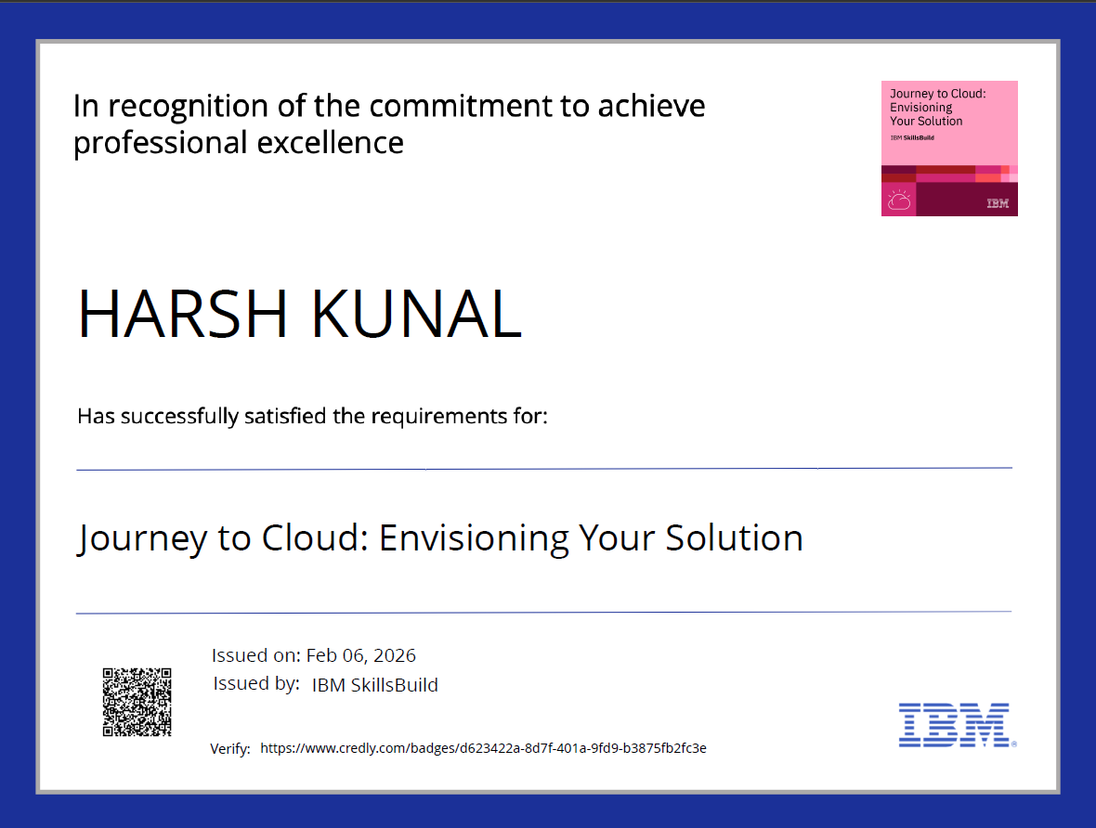
CERTIFICATES

Slide 12

CERTIFICATES

Slide 13
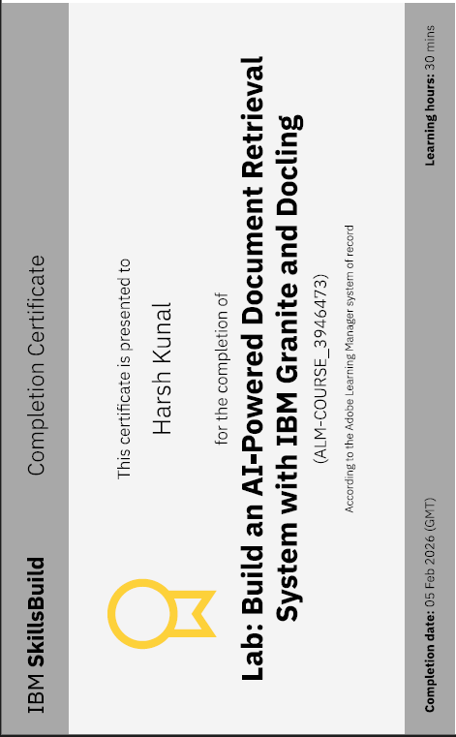
CERTIFICATES

Slide 14
Conclusion
Summarize the key findings and evaluate the effectiveness of the proposed solution in tracking maternal health progress. Highlight challenges faced during data collection, analysis, or implementation phases, as well as opportunities for future improvements. Emphasize the critical role of accurate and timely data analysis in ensuring equitable maternal health services, ultimately contributing to public health and progress toward Sustainable Development Goals.

Slide 15
Github

Slide 16
Future scope
Incorporate additional maternal health data sources such as real-time hospital records, wearable health devices, and mobile health apps.
Optimize prediction algorithms using advanced machine learning techniques to identify risk factors and recommend targeted interventions.
Expand system to cover multiple states/regions for comparative analysis and resource allocation.
Integrate emerging technologies such as IoT-enabled maternal monitoring systems and AI-based health risk prediction.
Enable real-time alerts for high-risk pregnancies to reduce maternal mortality.

Slide 17
References
List and cite relevant sources, research papers, and articles that were instrumental in developing the proposed solution. This could include academic papers on maternal health prediction, machine learning algorithms, and best practices in healthcare data analysis.

Slide 18
THANK YOU

